Slide 1
Neural Networks for Machine Learning Lecture 15a From Principal Components Analysis to Autoencoders

Slide 2
Principal Components Analysis
This takes N-dimensional data and finds the M orthogonal directions in which the data have the most variance.
These M principal directions form a lower-dimensional subspace.
We can represent an N-dimensional datapoint by its projections onto the M principal directions.
This loses all information about where the datapoint is located in the remaining orthogonal directions.
We reconstruct by using the mean value (over all the data) on the N-M directions that are not represented.
The reconstruction error is the sum over all these unrepresented directions of the squared differences of the datapoint from the mean.

Slide 3
A picture of PCA with N=2 and M=1
The red point is represented by the green point. The “reconstruction” of the red point has an error equal to the squared distance between red and green points.
direction of first principal component i.e. direction of greatest variance

Slide 4
Using backpropagation to implement PCA inefficiently
Try to make the output be the same as the input in a network with a central bottleneck.
The activities of the hidden units in the bottleneck form an efficient code.
If the hidden and output layers are linear, it will learn hidden units that are a linear function of the data and minimize the squared reconstruction error.
This is exactly what PCA does.
The M hidden units will span the same space as the first M components found by PCA
Their weight vectors may not be orthogonal.
They will tend to have equal variances.
output vector
code
input vector

Slide 5
Using backpropagation to generalize PCA
With non-linear layers before and after the code, it should be possible to efficiently represent data that lies on or near a non-linear manifold.
The encoder converts coordinates in the input space to coordinates on the manifold.
The decoder does the inverse mapping.
output vector
decoding weights
code
encoding weights
input vector

Slide 6
Neural Networks for Machine Learning Lecture 15b Deep Autoencoders

Slide 7
Deep Autoencoders
They always looked like a really nice way to do non-linear dimensionality reduction:
They provide flexible mappings both ways.
The learning time is linear (or better) in the number of training cases.
The final encoding model is fairly compact and fast.
But it turned out to be very difficult to optimize deep autoencoders using backpropagation.
With small initial weights the backpropagated gradient dies.
We now have a much better ways to optimize them.
Use unsupervised layer-by-layer pre-training.
Or just initialize the weights carefully as in Echo-State Nets.

Slide 8
The first really successful deep autoencoders (Hinton & Salakhutdinov, Science, 2006)
784 → 1000 → 500 → 250
30 linear units
784 ← 1000 ← 500 ← 250
We train a stack of 4 RBM’s and then “unroll” them.
Then we fine-tune with gentle backprop.

Slide 9
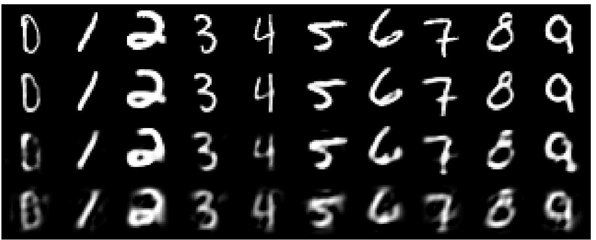
A comparison of methods for compressing digit images to 30 real numbers
real data
30-D deep auto
30-D PCA

Slide 10
Neural Networks for Machine Learning Lecture 15c Deep autoencoders for document retrieval and visualization

Slide 11
How to find documents that are similar to a query document
0 0 2 2 0 2 1 1 0 0 2
fish cheese vector count school query reduce bag pulpit iraq word
Convert each document into a “bag of words”.
This is a vector of word counts ignoring order.
Ignore stop words (like “the” or “over”)
We could compare the word counts of the query document and millions of other documents but this is too slow.
So we reduce each query vector to a much smaller vector that still contains most of the information about the content of the document.

Slide 12
How to compress the count vector
output vector
2000 reconstructed counts
We train the neural network to reproduce its input vector as its output
This forces it to compress as much information as possible into the 10 numbers in the central bottleneck.
These 10 numbers are then a good way to compare documents.
500 neurons
250 neurons
10
250 neurons
500 neurons
input vector
2000 word counts

Slide 13
The non-linearity used for reconstructing bags of words
Divide the counts in a bag of words vector by N, where N is the total number of non-stop words in the document.
The resulting probability vector gives the probability of getting a particular word if we pick a non-stop word at random from the document.
At the output of the autoencoder, we use a softmax.
The probability vector defines the desired outputs of the softmax.
When we train the first RBM in the stack we use the same trick.
We treat the word counts as probabilities, but we make the visible to hidden weights N times bigger than the hidden to visible because we have N observations from the probability distribution.

Slide 14
Performance of the autoencoder at document retrieval
Train on bags of 2000 words for 400,000 training cases of business documents.
First train a stack of RBM’s. Then fine-tune with backprop.
Test on a separate 400,000 documents.
Pick one test document as a query. Rank order all the other test documents by using the cosine of the angle between codes.
Repeat this using each of the 400,000 test documents as the query (requires 0.16 trillion comparisons).
Plot the number of retrieved documents against the proportion that are in the same hand-labeled class as the query document. Compare with LSA (a version of PCA).

Slide 15
Retrieval performance on 400,000 Reuters business news stories

Slide 16
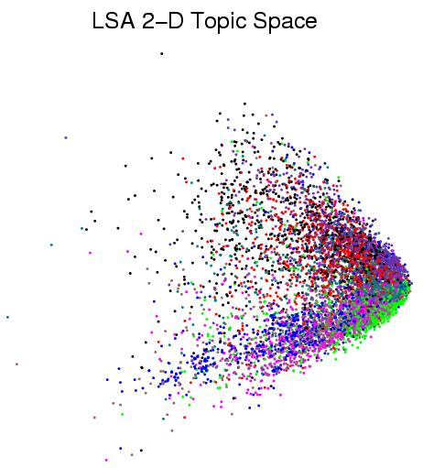
First compress all documents to 2 numbers using PCA on log(1+count). Then use different colors for different categories.

Slide 17
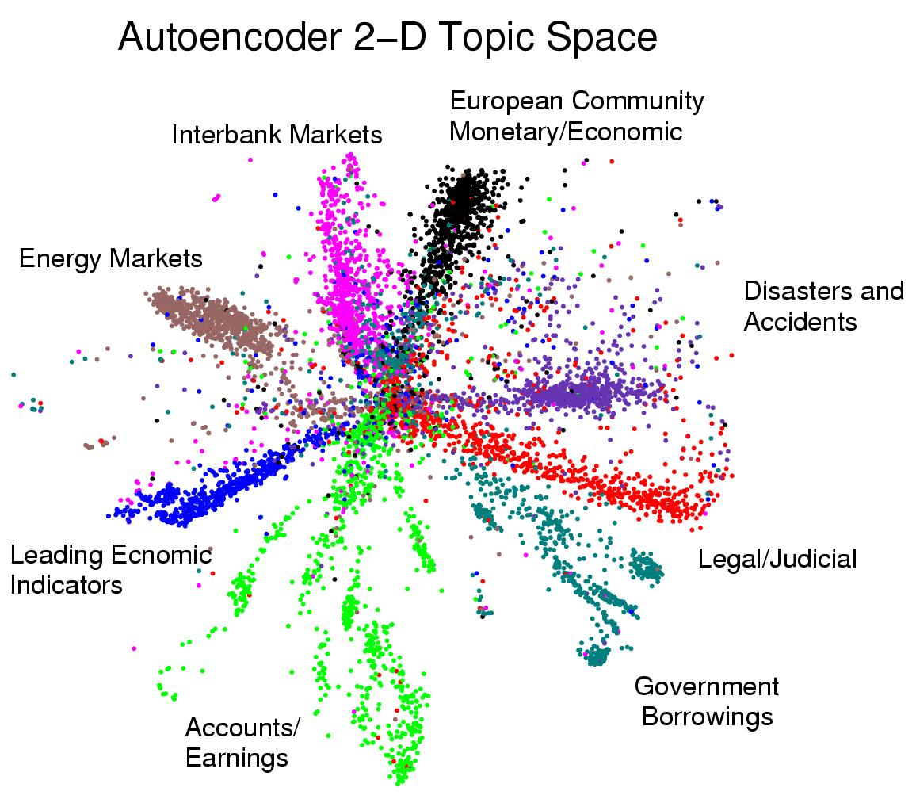
First compress all documents to 2 numbers using deep auto. Then use different colors for different document categories

Slide 18
Neural Networks for Machine Learning Lecture 15d Semantic hashing

Slide 19
Finding binary codes for documents
Train an auto-encoder using 30 logistic units for the code layer.
During the fine-tuning stage, add noise to the inputs to the code units.
The noise forces their activities to become bimodal in order to resist the effects of the noise.
Then we simply threshold the activities of the 30 code units to get a binary code.
Krizhevsky discovered later that its easier to just use binary stochastic units in the code layer during training.
2000 reconstructed counts
500 neurons
250 neurons
30
code
250 neurons
500 neurons
2000 word counts

Slide 20
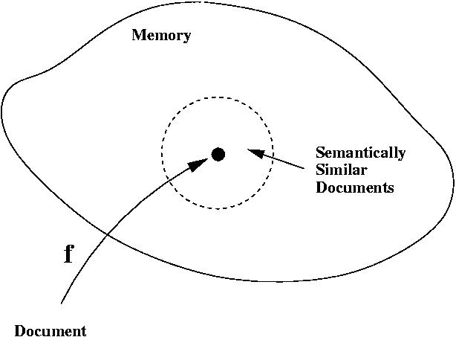
Using a deep autoencoder as a hash-function for finding approximate matches
supermarket search
hash function

Slide 21
Another view of semantic hashing
Fast retrieval methods typically work by intersecting stored lists that are associated with cues extracted from the query.
Computers have special hardware that can intersect 32 very long lists in one instruction.
Each bit in a 32-bit binary code specifies a list of half the addresses in the memory.
Semantic hashing uses machine learning to map the retrieval problem onto the type of list intersection the computer is good at.

Slide 22
Neural Networks for Machine Learning Lecture 15e Learning binary codes for image retrieval

Slide 23
Binary codes for image retrieval
Image retrieval is typically done by using the captions. Why not use the images too?
Pixels are not like words: individual pixels do not tell us much about the content.
Extracting object classes from images is hard (this is out of date!)
Maybe we should extract a real-valued vector that has information about the content?
Matching real-valued vectors in a big database is slow and requires a lot of storage.
Short binary codes are very easy to store and match.

Slide 24
A two-stage method
First, use semantic hashing with 28-bit binary codes to get a long “shortlist” of promising images.
Then use 256-bit binary codes to do a serial search for good matches.
This only requires a few words of storage per image and the serial search can be done using fast bit-operations.
But how good are the 256-bit binary codes?
Do they find images that we think are similar?

Slide 25
Krizhevsky’s deep autoencoder
The encoder has about 67,000,000 parameters.
256-bit binary code
512
There is no theory to justify this architecture
It takes a few days on a GTX 285 GPU to train on two million images.
1024
2048
4096
8192
1024
1024
1024

Slide 26

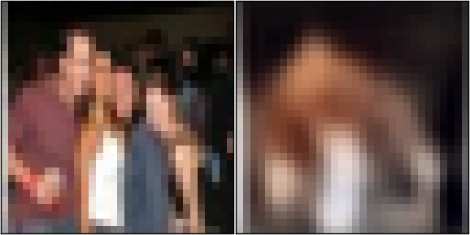

Reconstructions of 32x32 color images from 256-bit codes

Slide 27
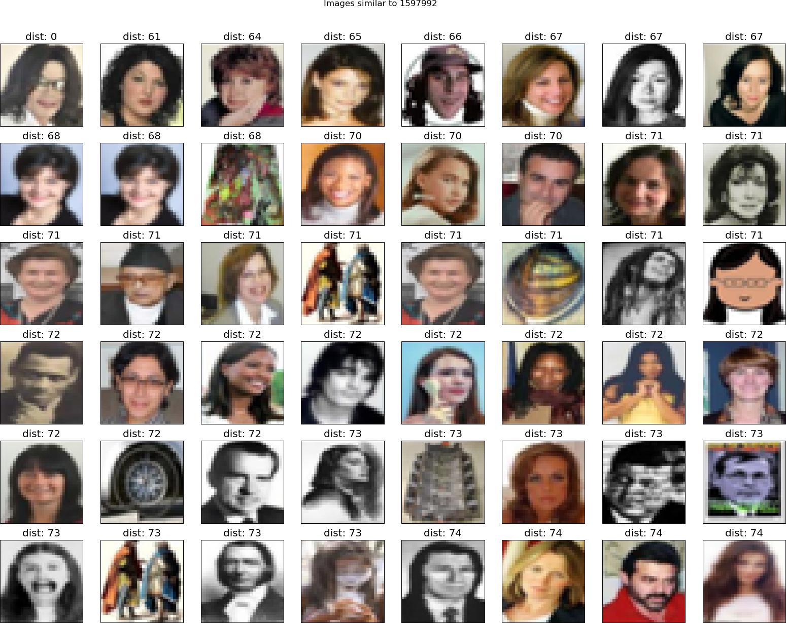
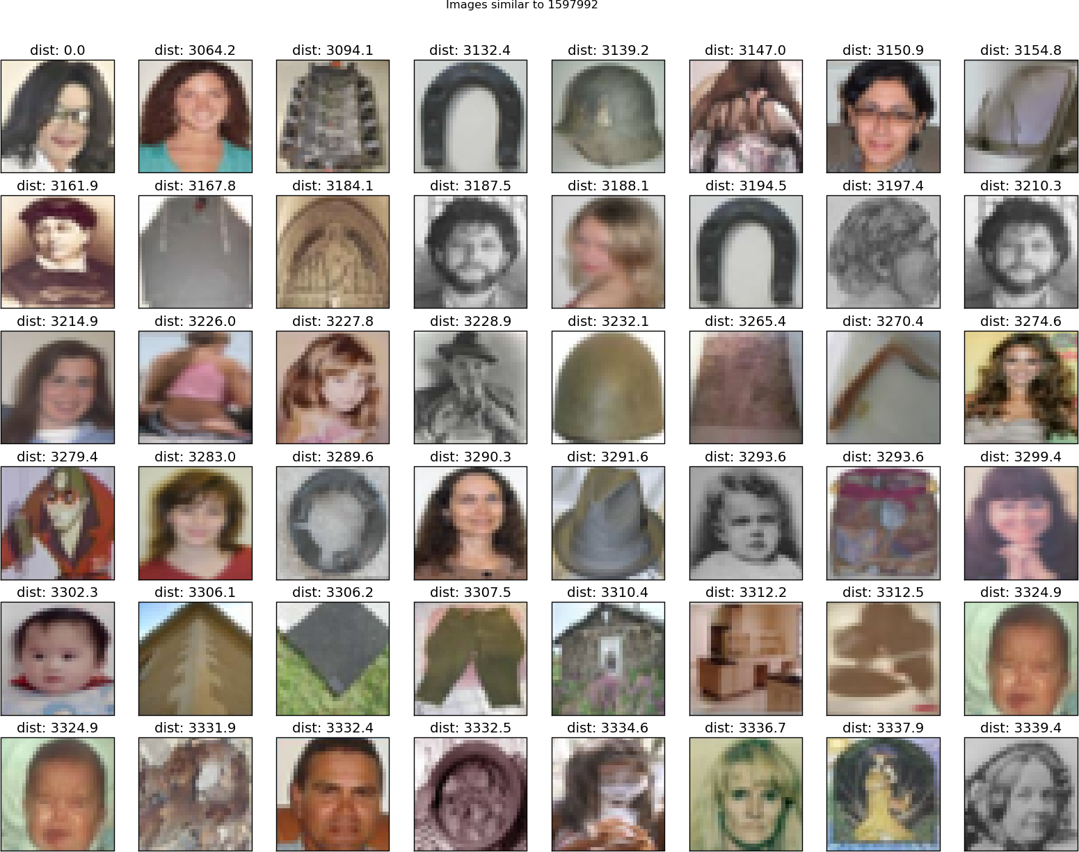
retrieved using 256 bit codes
retrieved using Euclidean distance in pixel intensity space

Slide 28
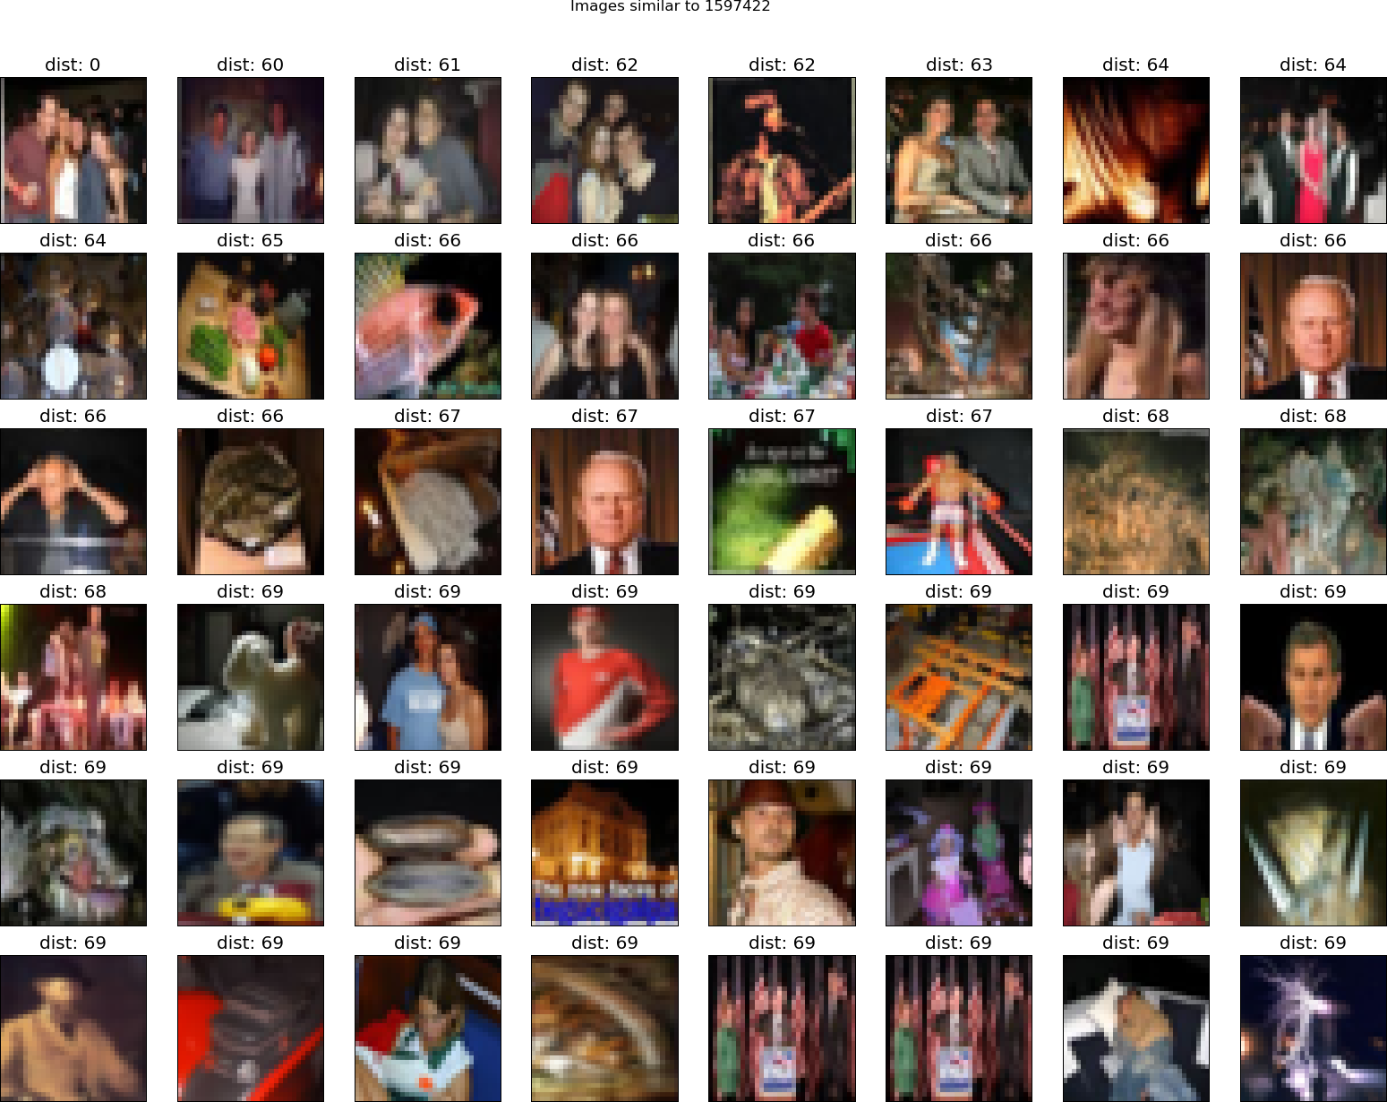
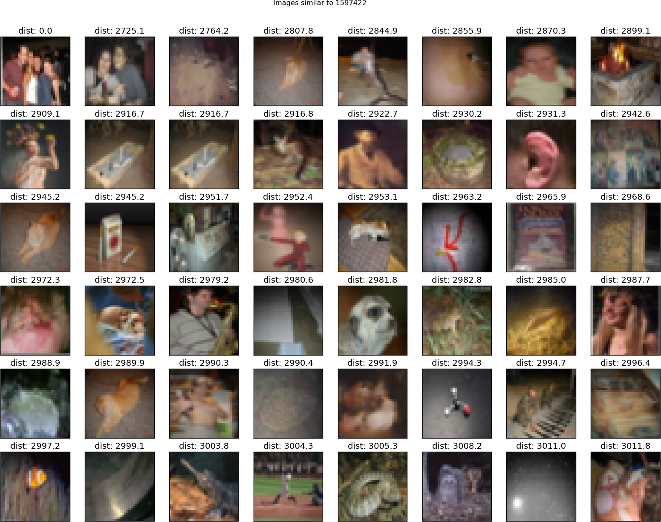
retrieved using 256 bit codes
retrieved using Euclidean distance in pixel intensity space

Slide 29
How to make image retrieval more sensitive to objects and less sensitive to pixels
First train a big net to recognize lots of different types of object in real images.
We saw how to do that in lecture 5.
Then use the activity vector in the last hidden layer as the representation of the image.
This should be a much better representation to match than the pixel intensities.
To see if this approach is likely to work, we can use the net described in lecture 5 that won the ImageNet competition.
So far we have only tried using the Euclidian distance between the activity vectors in the last hidden layer.
It works really well!
Will it work with binary codes?

Slide 30
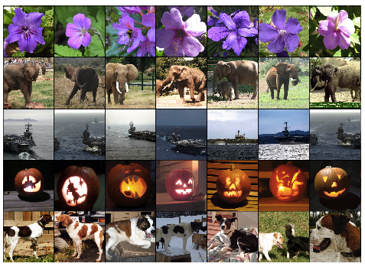
Leftmost column is the search image.
Other columns are the images that have the most similar feature activities in the last hidden layer.

Slide 31
Neural Networks for Machine Learning Lecture 15f Shallow autoencoders for pre-training

Slide 32
RBM’s as autoencoders
When we train an RBM with one-step contrastive divergence, it tries to make the reconstructions look like data.
It’s like an autoencoder, but it’s strongly regularized by using binary activities in the hidden layer.
When trained with maximum likelihood, RBMs are not like autoencoders.
Maybe we can replace the stack of RBM’s used for pre-training by a stack of shallow autoencoders?
Pre-training is not as effective (for subsequent discrimination) if the shallow autoencoders are regularized by penalizing the squared weights.

Slide 33
Denoising autoencoders (Vincent et. al. 2008)
Denoising autoencoders add noise to the input vector by setting many of its components to zero (like dropout, but for inputs).
They are still required to reconstruct these components so they must extract features that capture correlations between inputs.
Pre-training is very effective if we use a stack of denoising autoencoders.
It’s as good as or better than pre-training with RBMs.
It’s also simpler to evaluate the pre-training because we can easily compute the value of the objective function.
It lacks the nice variational bound we get with RBMs, but this is only of theoretical interest.

Slide 34
Contractive autoencoders (Rifai et. al. 2011)
Another way to regularize an autoencoder is to try to make the activities of the hidden units as insensitive as possible to the inputs.
But they cannot just ignore the inputs because they must reconstruct them.
We achieve this by penalizing the squared gradient of each hidden activity w.r.t. the inputs.
Contractive autoencoders work very well for pre-training.
The codes tend to have the property that only a small subset of the hidden units are sensitive to changes in the input.
But for different parts of the input space, its a different subset. The active set is sparse.
RBMs behave similarly.

Slide 35
Conclusions about pre-training
There are now many different ways to do layer-by-layer pre-training of features.
For datasets that do not have huge numbers of labeled cases, pre-training helps subsequent discriminative learning.
Especially if there is extra data that is unlabeled but can be used for pretraining.
For very large, labeled datasets, initializing the weights used in supervised learning by using unsupervised pre-training is not necessary, even for deep nets.
Pre-training was the first good way to initialize the weights for deep nets, but now there are other ways.
But if we make the nets much larger we will need pre-training again!

